Slide 1

SIMATS ENGINEERING
SAVEETHA INSTITUTE OF MEDICAL AND TECHNICAL SCIENCES CHENNAI-602105
Design of a Hospital Patient Record Management System Using Relational DBMS
CSA0502 - Database Management System
Supervisors
Dr.G.Ayyappan Professor,
SIMATS Engineering
presented by
Christilla Sweety J S (192421141)
Sandhya K (192424061)

Slide 2
ABSTRACT
The Hospital Patient Record Management System is a database-based application designed to store, manage, and retrieve important hospital information efficiently. It maintains details of patients, doctors, appointments, and medical records in an organized manner. The system uses relational database concepts and SQL queries to perform operations such as adding, updating, deleting, and searching records. It reduces manual paperwork, minimizes data errors and duplication, and provides quick access to patient information. Overall, the system improves the efficiency, accuracy, and organization of hospital record management.

Slide 3
OBJECTIVES
To design a relational database system for efficient management of hospital patient records.
To securely store and manage patient details, medical history, doctor information, appointments, and billing records.
To provide efficient data insertion, updating, searching, and retrieval using SQL queries.
To maintain data accuracy, consistency, and integrity using primary keys, foreign keys, and relational constraints.

Slide 4
PROBLEM STATEMENT
Hospitals manage large amounts of patient information, making manual record management difficult, time-consuming, and error-prone.
Patient details, medical history, appointments, and billing information are often stored separately, making it difficult to retrieve and maintain records efficiently.
A centralized relational database system is required to securely store, organize, update, and retrieve hospital patient records while maintaining data accuracy and consistency.

Slide 5
LITERATURE REVIEW
AUTHOR | TITLE | KEY FINDINGS
Kumar et al., 2024 | Hospital Patient Record Management System | Improves the organization and accessibility of patient records.
Sharma et al., 2025 | Relational Database for Hospital Management | Reduces data redundancy and improves patient data accuracy.
Patel et al., 2026 | Smart Patient Record System Using DBMS | Enables faster retrieval and efficient management of patient information.
Raj et al., 2025 | Database-Based Hospital Management System | Supports efficient management of patients, doctors, appointments, and treatments.
Singh et al., 2024 | Secure Electronic Patient Record System | Enhances data consistency, security, and reliable access to medical records.

Slide 6
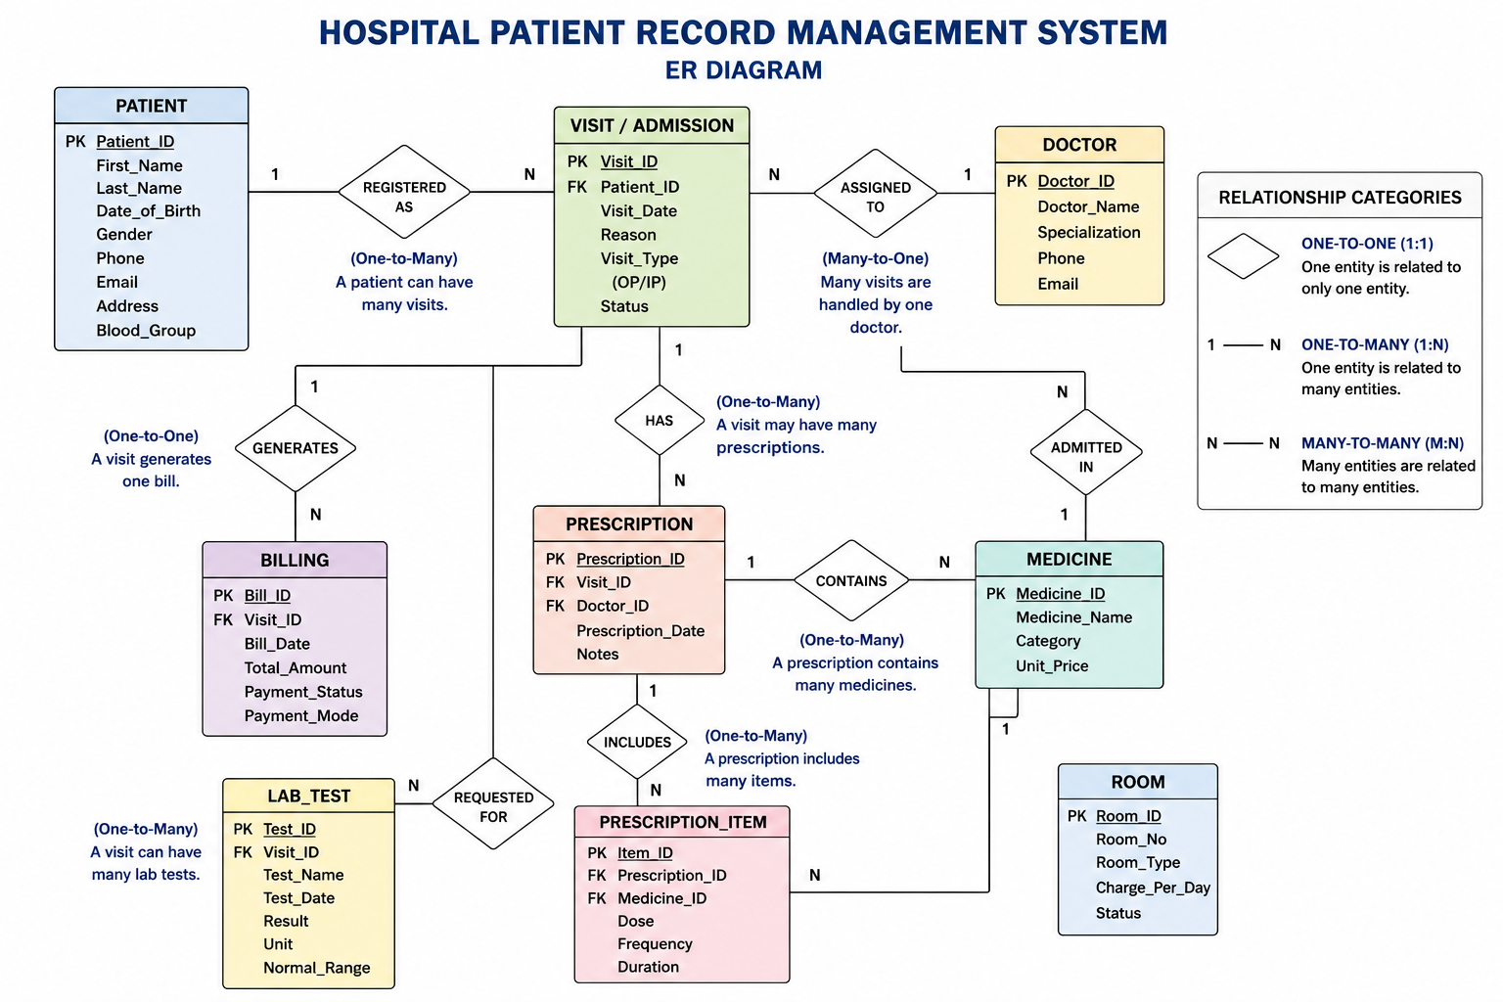
ER DIAGRAM

Slide 7
LIST OF MODULES
Module 1: Patient Registration Module
Module 2: Medical History Tracker
Module 3: Appointment & Billing Module

Slide 8
MODULE 1 : PATIENT REGISTRATION MODULE
METHODOLOGY:
Requirement Analysis – Identify the requirements for managing patients, doctors, medical history, appointments, and billing.
Database Design – Design relational tables with appropriate fields, primary keys, and foreign keys.
Data Management – Perform operations such as insert, update, delete, search, and retrieve patient records.
Relationship Management – Establish relationships between patients, doctors, appointments, medical history, and billing tables.
Testing – Test SQL queries and database operations to ensure accuracy and data consistency.
TOOLS USEDS :
MySQL – Database management
SQL – Create, insert, update, delete, and search patient records
MySQL Workbench – Execute and test SQL queries

Slide 9
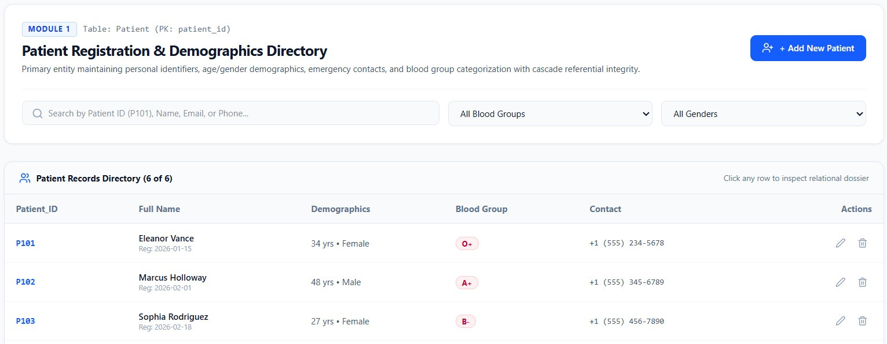
implementation

Slide 10
MODULE 2 : MEDICAL HISTORY TRACKER
METHODOLOGY:
Doctor and Medical History Table Creation – Create tables to store doctor and patient medical information.
Relationship Establishment – Connect Patient, Doctor, and Medical History tables using foreign keys.
Medical Data Entry – Add diagnosis, treatment, prescription, and doctor notes.
Data Retrieval – Use SQL queries to view and search a patient’s medical history.
Data Maintenance – Update medical records whenever new diagnosis or treatment information is available.
TOOLS USEDS :
MySQL – Store and manage medical history and doctor records.
SQL – Insert, update, search, and retrieve medical history.
MySQL Workbench – Create tables and execute SQL queries.

Slide 11
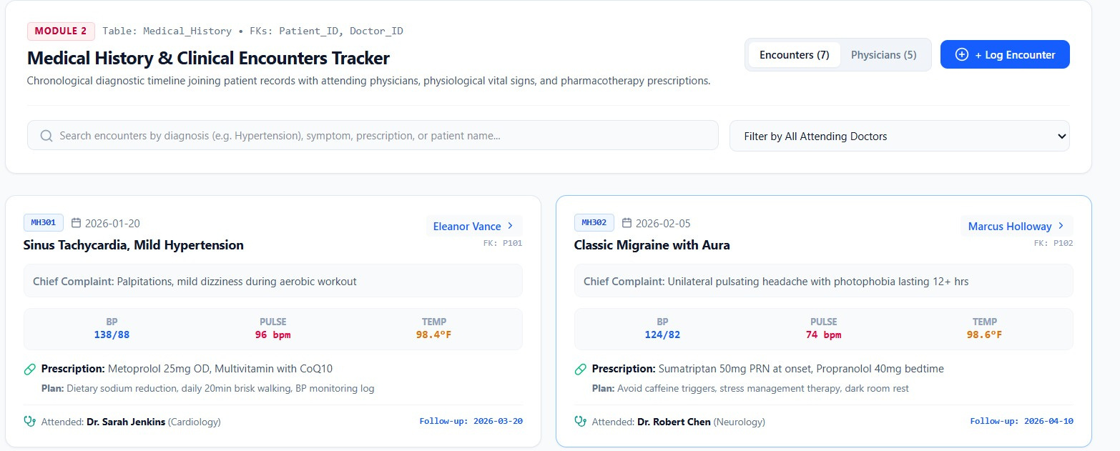
IMPLEMENTATION

Slide 12
MODULE 3 : APPOINTMENT & BILLING MODULE
METHODOLOGY:
Appointment Table Creation – Create a table to store patient appointments, doctor details, date, time, and status.
Billing Table Creation – Store consultation, laboratory, medicine fees, total amount, and payment status.
Relationship Establishment – Connect Patient, Doctor, Appointment, and Billing tables using foreign keys.
Appointment Management – Add, update, and retrieve appointment details.
Bill Generation – Calculate and store the total billing amount for each appointment.
Payment Tracking – Track whether the bill is paid or pending using the payment status.
TOOLS USEDS :
MySQL – Manage appointment and billing records.
SQL – Create tables, insert appointment details, generate bills, and track payments.
MySQL Workbench – Execute and test SQL queries.

Slide 13
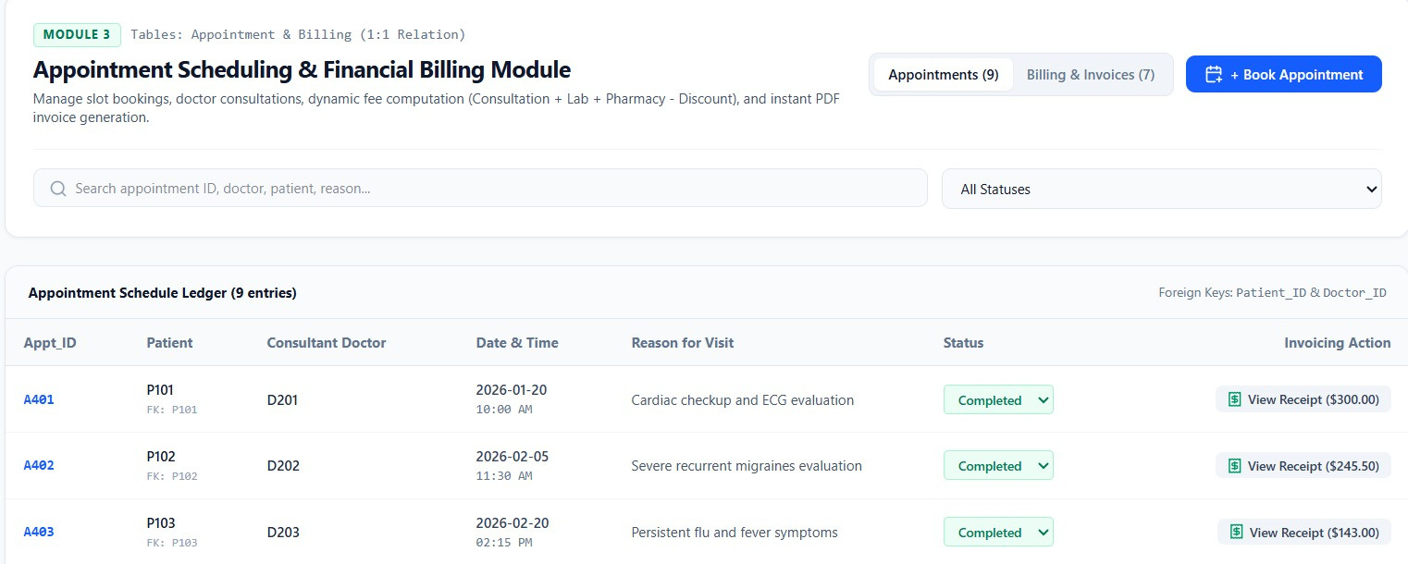
IMPLEMENTATION

Slide 14
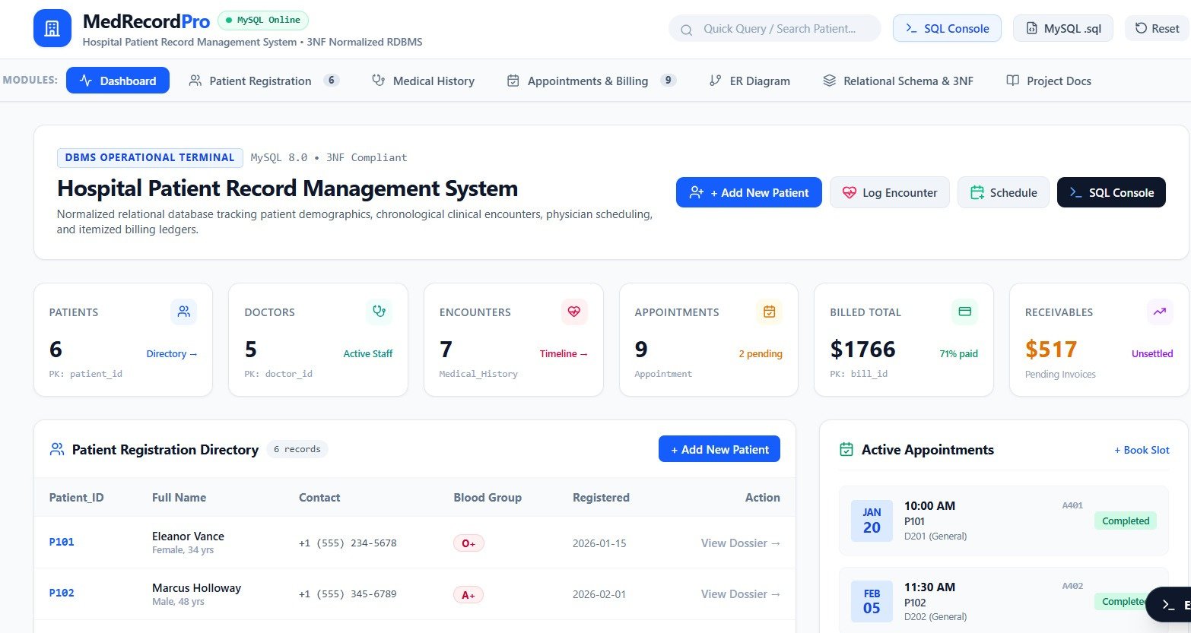
IMPLEMENTATION

Slide 15
FUTURE ENHANCEMENTS
Allow patients to book, reschedule, and cancel hospital appointments online.
Develop a mobile application for patients and doctors to access medical records and appointments.
Implement cloud-based storage and automatic backup for secure and reliable patient data management.
Integrate AI-based healthcare support to analyze medical history and assist doctors in decision-making.

Slide 16
CONCLUSION
The system provides an efficient and organized method for managing hospital patient records.
It securely manages patient details, medical history, doctor information, appointments, and billing records.
Relational database concepts such as primary keys and foreign keys maintain data accuracy and consistency.
The system reduces manual work, improves data retrieval, and supports better hospital record management.

Slide 17
REFERENCES
Elmasri, R., & Navathe, S. B. (2024). Fundamentals of Database Systems. Pearson.
Silberschatz, A., Korth, H. F., & Sudarshan, S. (2025). Database System Concepts. McGraw-Hill.
Date, C. J. (2024). An Introduction to Database Systems. Pearson.
Connolly, T., & Begg, C. (2025). Database Systems: A Practical Approach to Design, Implementation, and Management. Pearson.
Ramakrishnan, R., & Gehrke, J. (2026). Database Management Systems. McGraw-Hill.

Slide 18
THANK YOU

